Slide 1
Learning Objective
I will be able to solve worded problems involving function notations
Success Criteria
At the end of the lesson, I will be able to:
Solve worded problems involving function notations.

Slide 2

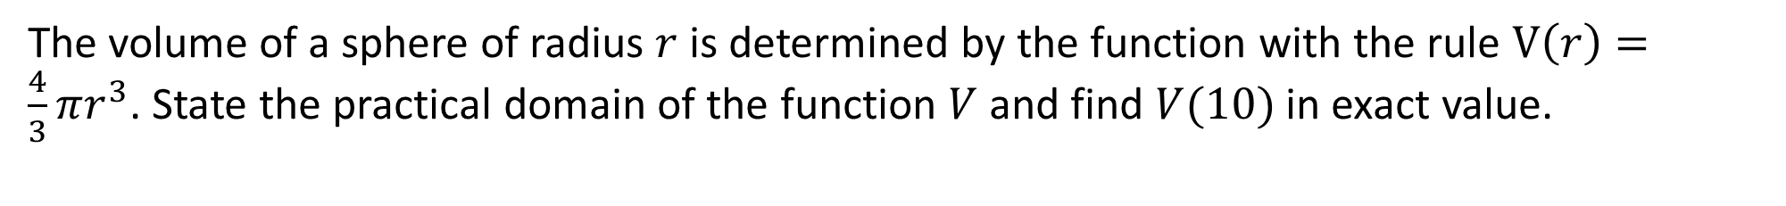
The volume of a sphere of radius $r$ is determined by the function with the rule $V\left(r\right)=\frac{4}{3}πr^{3}$. State the practical domain of the function $V$ and find $V(10)$ in exact value.
Cambridge Ch 6E Example 16
$r$ has to be greater than 0
Therefore, the practical domain is $\{r∈ℝ:r>0\}$
$$V\left(10\right)=\frac{4}{3}\left(π\right){\left(10\right)}^{3}=\frac{4000π}{3} units^{3}$$

Slide 3
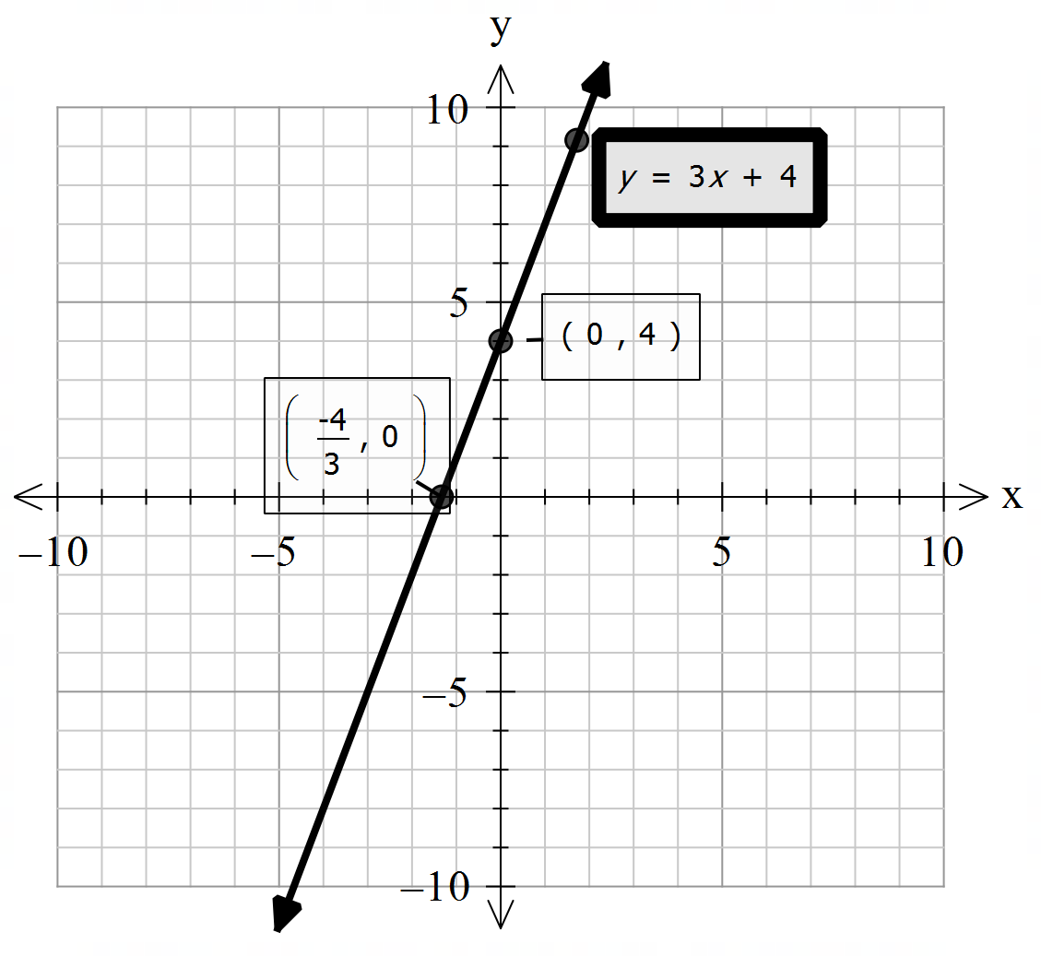

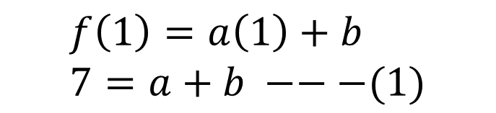


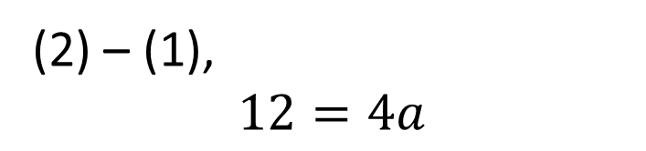
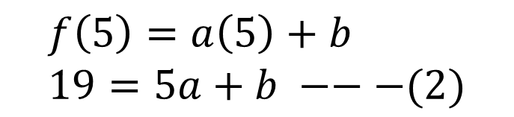
Cambridge Ch 6E Example 17
If $f:ℝ→ℝ$, $f\left(x\right)=ax+b$ such that $f\left(1\right)=7$ and $f\left(5\right)=19$, find $a$ and $b$ and sketch the graph of $y=f(x)$
$$f\left(1\right)=a\left(1\right)+b \\ 7=a+b −−−(1)$$
$$f\left(5\right)=a\left(5\right)+b \\ 19=5a+b −−−(2)$$
(2) – (1), $$12=4a$$
$$a=3$$
$$b=4$$
$$f\left(x\right)=3x+4$$

Slide 4


Cambridge Ch 6E Example 17
Find the quadratic function $f$ such that $f\left(4\right)=f\left(−2\right)=0$ and $f\left(0\right)=16$
Since $f\left(4\right)=f\left(−2\right)=0$, rewriting in coordinates $\left(4,0\right), (−2,0)$
These are $x−$intercepts, so using the factorized form:
$$f\left(x\right)=a(x−4)(x+2)$$
Substitute $f\left(0\right)=16$,
$$16=a(0−4)(0+2)$$
$$16=−8a$$
$$a=−2$$
$$∴f(x)=−2(x−4)(x+2)$$

Slide 5

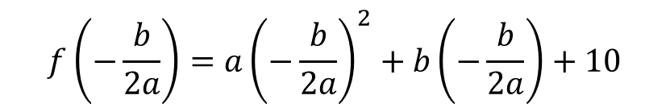












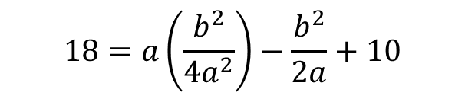


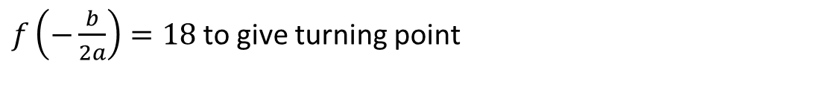


Cambridge Ch 6E Q8
Find the two quadratic function $f$ and $g$ such that $f\left(1\right)=0, g\left(1\right)=0$ and $f\left(0\right)=10, g\left(0\right)=10$ and both have a maximum value of 18.
$$f\left(−\frac{b}{2a}\right)=a{\left(−\frac{b}{2a}\right)}^{2}+b\left(−\frac{b}{2a}\right)+10$$
Let :
$$f\left(x\right)=ax^{2}+bx+c$$
Substitute $f\left(0\right)=10,$
$$18=a\left(\frac{b^{2}}{4a^{2}}\right)−\frac{b^{2}}{2a}+10$$
$$b=40,b=−8$$
$$c=10$$
Substitute $f\left(1\right)=0$
$$8=\frac{b^{2}}{4a}−\frac{b^{2}}{2a}$$
$$b=40,a=−50$$
$$0=a+b+10 \\ a=−b−10$$
$$b=−8, a=−2$$
$$8=−\frac{b^{2}}{4a}$$
Axis of symmetry is:
$$x=−\frac{b}{2a}$$
$$f\left(x\right)=−2x^{2}−8x+10$$
$$b^{2}=−32a$$
$$g\left(x\right)=−50x^{2}+40x+10$$
$$b^{2}=−32(−b−10)$$
$f\left(−\frac{b}{2a}\right)=18$ to give turning point
$$b^{2}−32b−320=0$$
$$\left(b−40\right)\left(b+8\right)=0$$

Slide 6
Independent Practice
Complete Cambridge Ex 6E exclude Q9

